Slide 1
Chapters 4 & 6 z-scores, Outliers, and Bias

Slide 2
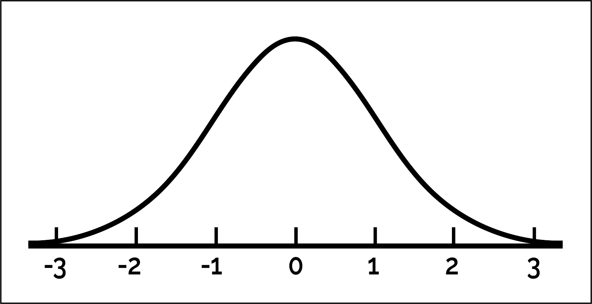
Reminder: The Normal Distribution

Slide 3
Normal Distribution Properties (1)
Shape & Symmetry
  It's a continuous, bell-shaped curve that is perfectly symmetric around its center (mean)
Center Characteristics
  In a perfectly normal distribution, the mean (μ), median, and mode all coincide at the center peak
Standard Deviation Controls Spread
  The width of the curve is determined by the standard deviation (σ). Smaller σ means a narrower, taller curve; larger σ means a wider, flatter curve

Slide 4
Normal Distribution Properties (2)
Empirical Rule (68–95–99.7 Rule)
  ~68% of values fall within ±1σ from the mean
  ~95% fall within ±2σ
  ~99.7% fall within ±3σ
Using this information, we can determine the probability of finding any value on the distribution!
p-values!

Slide 5
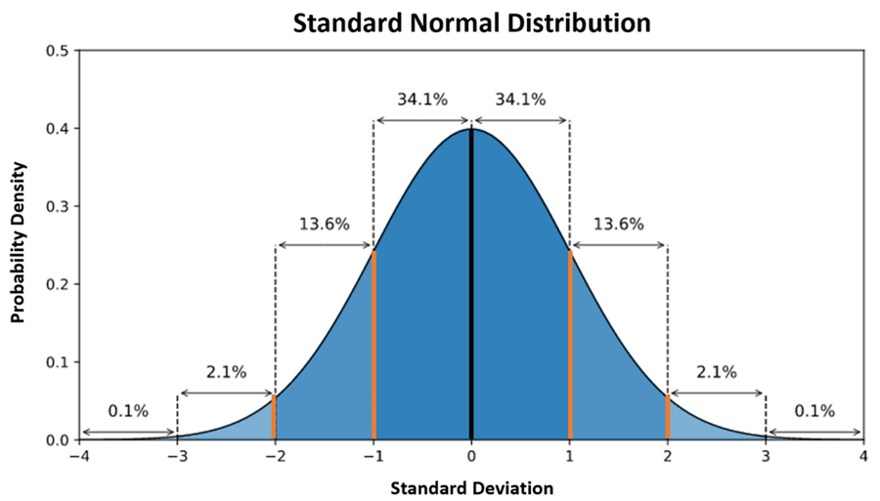
The Standard Normal Distribution

Slide 6
z-scores
z-scores express distance in terms of standard deviation units
  How many standard deviations a data point (x) is from the mean (μ)
  Direction and magnitude
    Positive z-scores == above the mean
    Negative z-scores == below the mean

Slide 7
z-scores and the normal distribution
z-scores link raw data to the normal distribution
How? Any score in a distribution can be transformed to a z-score as long as you know…
The mean and sd of the distribution!

Slide 8
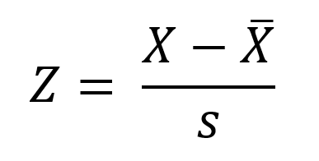
z-score formula

Slide 9
Assumptions of the normal distribution
Parametric tests based on the normal distribution assume:
  Additivity and linearity
  Normality something or other
  Homogeneity of Variance
  Independence

Slide 10
Additivity and Linearity
The outcome variable is, in reality, linearly related to any predictors.
If you have several predictors then their combined effect is best described by adding their effects together.
If this assumption is not met, then your model is invalid.

Slide 11
Normally Distributed Something or Other
The normal distribution is relevant to:
  Parameters
  Null hypothesis significance testing
This assumption tends to get incorrectly translated as ‘your data need to be normally distributed’.
Instead, the sampling distribution of the test statistic (e.g., the mean) must be normal, not necessarily that the raw data itself follow a bell curve

Slide 12
When does the Assumption of Normality Matter?
In small samples.
  The central limit theorem allows us to forget about this assumption in larger samples.
  Precision improves with sample size
  If n is large enough, the data will usually end up normally distributed
In practical terms, as long as your sample is fairly large, outliers are a much more pressing concern than normality.

Slide 13
What are Outliers?
Observations that significantly deviate from most of the data—these can be due to errors, rare events, or true variability
Examples?
Problematic because they can distort measures like the mean and variance, leading to incorrect conclusions

Slide 14
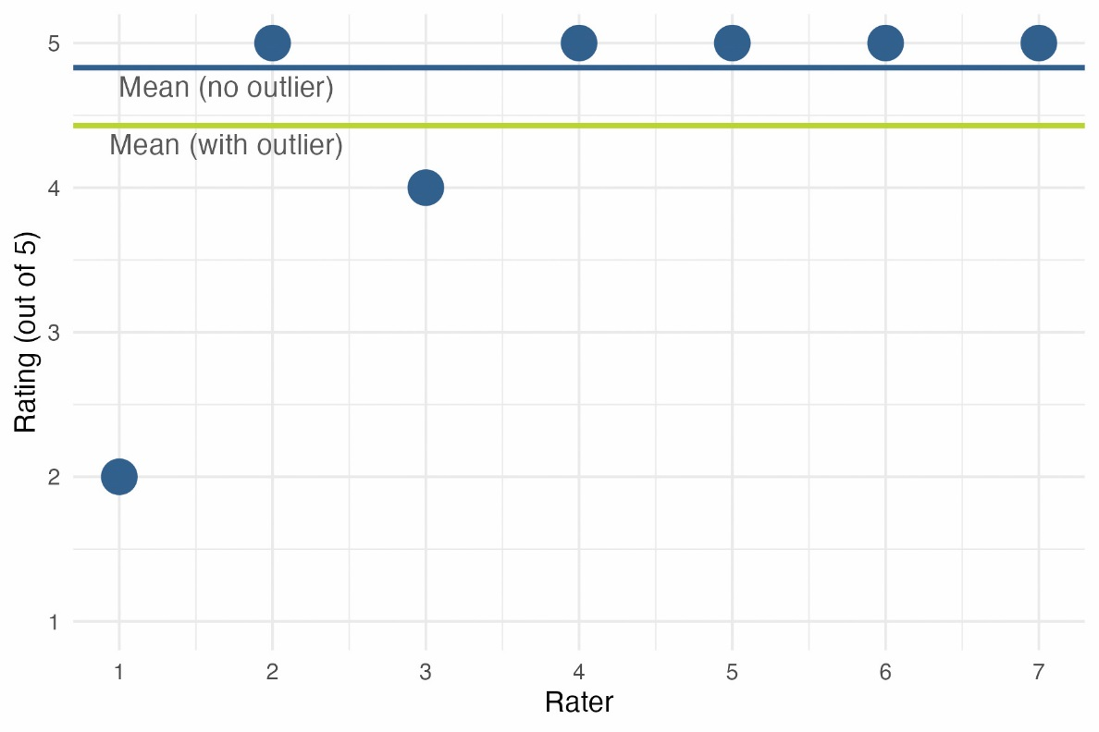
Outliers Can Bias a Parameter Estimate
Notes:
Figure 6.10 The first seven customer ratings of the first edition of this book on www.amazon.co.uk (in about 2002). The first score biases the mean

Slide 15
Homoscedasticity/ Homogeneity of Variance (1 of 2)
When testing several groups of participants, samples should come from populations with the same variance.
In correlational designs, the variance of the outcome variable should be stable at all levels of the predictor variable.

Slide 16
Homoscedasticity/ Homogeneity of Variance (2 of 2)
Can affect the two main things that we might do when we fit models to data:
  Parameters (like the mean)
  Null hypothesis significance testing (can influence p-values)

Slide 17
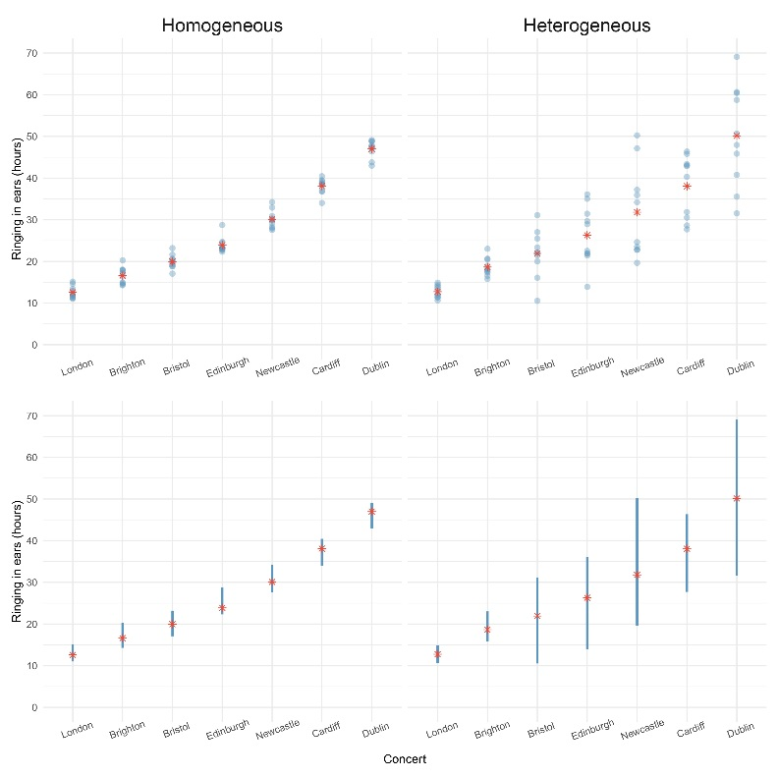
Homogeneity of Variance

Slide 18
Independence
The errors in your model should not be related to each other.
If this assumption is violated:
  Confidence intervals and significance tests will be invalid.
  More broadly, suggests that there is some confounding or outside variable that is impacting performance on a measure

Slide 19
Spotting Outliers
Visual check (graphs are incredibly helpful!)
z-scores (remember that z-scores are linked to probabilities, so extreme z-scores == extreme scores!)
What do with outliers?

Slide 20
Example
A biologist was worried about the potential health effects of music festivals.
Measured the hygiene of 810 concert-goers over the three days of the festival.
Hygiene was measured using a standardized technique:
  Score ranged from 0 to 4
    0 = you smell like a corpse rotting up a skunk’s arse
    4 = you smell of sweet roses on a fresh spring day

Slide 21
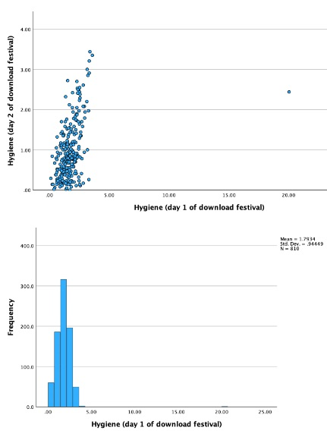
Spotting Outliers with Graphs
Notes:
Figure 6.18 Scatterplot (top), histogram (middle) and boxplot (bottom) of hygiene scores on day 1 of the Download Festival
Spot the outlier handout

Slide 22
Convert Raw Scores to z-scores
Reminder: z-scores put the raw data into standard deviation units
  z = 0 → at the mean
  z > 0 → above the mean
  z < 0 → below the mean
How above or below the mean can a score be before it is considered an outlier?
Notes:
Figure 6.18 Scatterplot (top), histogram (middle) and boxplot (bottom) of hygiene scores on day 1 of the Download Festival
Spot the outlier handout

Slide 23
The Standard Normal Distribution

Slide 24
Spotting Normality (1 of 2)
We don’t have access to the sampling distribution so we usually test the observed data
Central Limit Theorem
If N > 30, the sampling distribution is normal anyway (arguably)
Graphical displays
P-P Plot (or Q-Q plot)
Histogram
Values of skew/kurtosis
0 in a normal distribution
Convert to z (by dividing value by SE)

Slide 25
Spotting Normality with Numbers: Skew and Kurtosis
To check that the distribution of scores is approximately normal, look at Q-Q plots, histograms and the values of skewness and kurtosis.
In a normal distribution, the dots on a Q-Q plot will fall along the diagonal line.
Positive values of skewness indicate too many low scores in the distribution. Negative values indicate a build-up of high scores.
Positive values of kurtosis indicate a heavy-tailed distribution; negative values indicate a light-tailed distribution.
The further the value is from zero, the more likely it is that the data are not normally distributed.

Slide 26
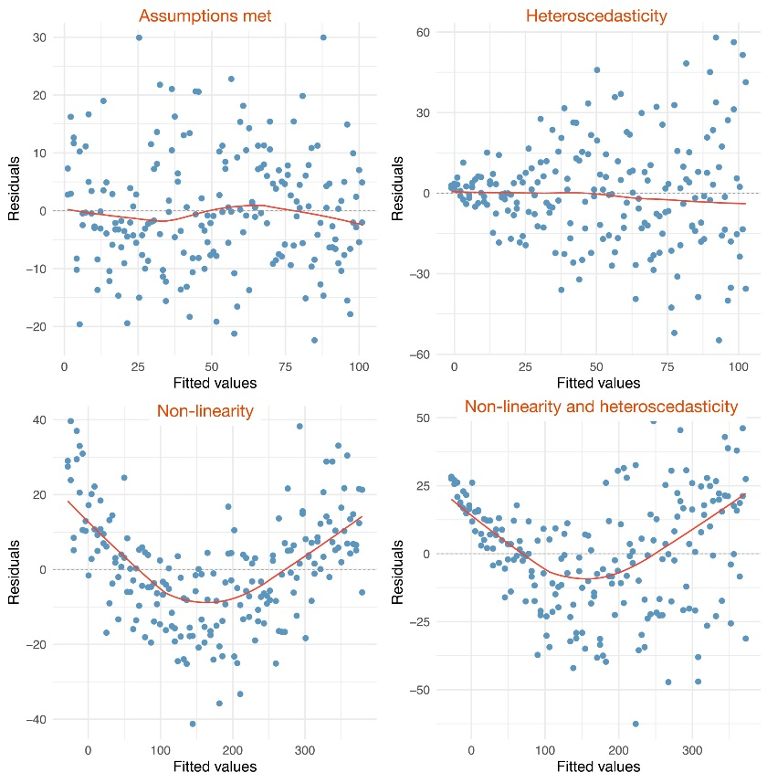
Spotting Problems with Linearity or Homoscedasticity

